Slide 1
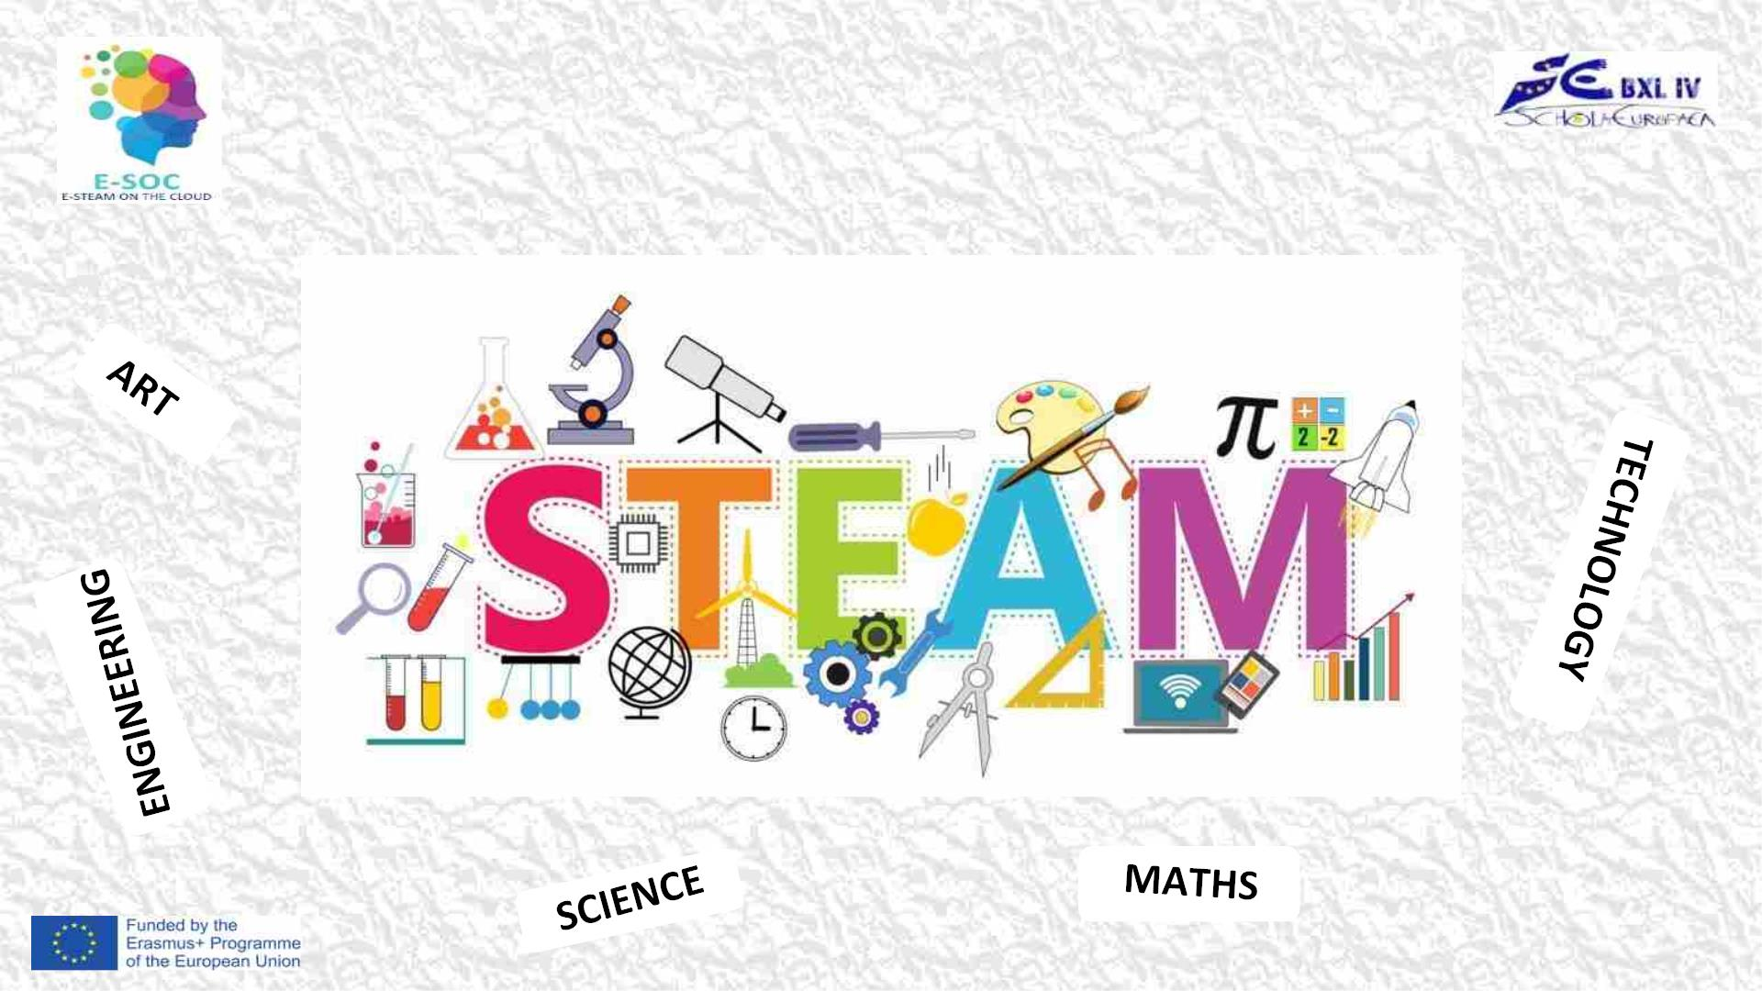
EQUALITY IN STEAM
Tekhnologic-
ppt template

Slide 2

The Wheel – it is a game to be used to review the knowledge about famous women/men in STEAM. It is a fun game that the students
will enjoy playing. The topic has been already taught and learned in class (by using the lesson plans activities from PR1 and PR2
of Erasmus ESOC project).
(slide 4)
The class will be divided by 5 groups consisted by 4 players each. To choose a group the pupils will use the spinner. Each group is
named by one of the subjects in STEAM education (Science, Technology,Engineering, Art and Maths). Then each group member should
also choose one of 4 colour bands (green, yellow, red, blue) by random, prepared by the teacher. It is possible that the group can be
more than 4 players like 6-8 persons. In that case the pupils will play by pairs with a same colour band. The level of difficulty of the
questions and challenges may vary it depends on the teacher's purpose. The time for each question or challenge may vary too (3 – 10
min. per pair).
(slide 5)
General presentation of the rules of the game for pupils. The teacher reads and explains the rules of the game.
(slide 6, …)
There are 20 colour circles (with a number of a question and a name of a group) and a spinning wheel (with the 4 colours and the name
of the groups). The circles are divided into four categories represented by four colours (green, yellow, blue and red). Clicking on one of
the circles will take you to the linked question slide. Each chosen slide has a question, task or/and challenge to be done. Answers are
not provided on the question slide. They are hidden at the end of the ppt presentation.
To start the spinner, the students click on the spin button in the centre and the arrow will rotate quickly. Click again and the arrow will
stop.
(Ex. The spinner stops on RED - ART. A member with a red band from group ART will answer to the question related with exactly the
same circle colour and name).
The teacher can have all answers with him/herself. Feedback must be given by the teacher. The teacher has the possibility to prepare
questions, tasks or challenges for the students as his/her own wish.
The correct, full answer of a question will bring to the group 3 points – max. 12 point per group. For answering a question each
participant will have max. 3 min. time (depends on the question). If there is a challenge the time can be more like 10 min. The teacher
writes the result on a board for each group.
The group, which all participants answer correctly and finish first all colour group questions, will be rewarded at first place.
The group of players that wins can be given a reward at the teacher’s discretion.

Slide 3

THE WHEEL
GAME
Spin!

Slide 4

CHOOSE A TEAM
Spin!
Select one of the 4 colour's band.

Slide 5

RULES OF THE GAME
1. There is a spinning wheel with the 4 colours and the
names of groups. To start the spinner, click on the spin
button in the centre and the arrow will rotate quickly.
Click again and the arrow will stop. The teacher starts
spinning the wheel. After that each participant, replying
to a question, spins the wheel.
1. There are 20 circles with a number and a name of
group. The circles are divided into four categories
represented by four colours (green, yellow, blue and
red). Clicking on one of the circles will take you to the
linked slide with a question, task or challenge to be
Spin!
done.
(Ex. The spinner stops on red - ART. A member with a red band from group ART
will answer to the question related with exactly the same circle colour and
name).
1. The correct and full answer of a question will bring to
the group 3 points – max. 12 points per group. For
answering a question each participant will have max. 3
min. time.
1. The group which all participants answer correctly and
finish first all colour group questions will be rewarded.

Slide 6
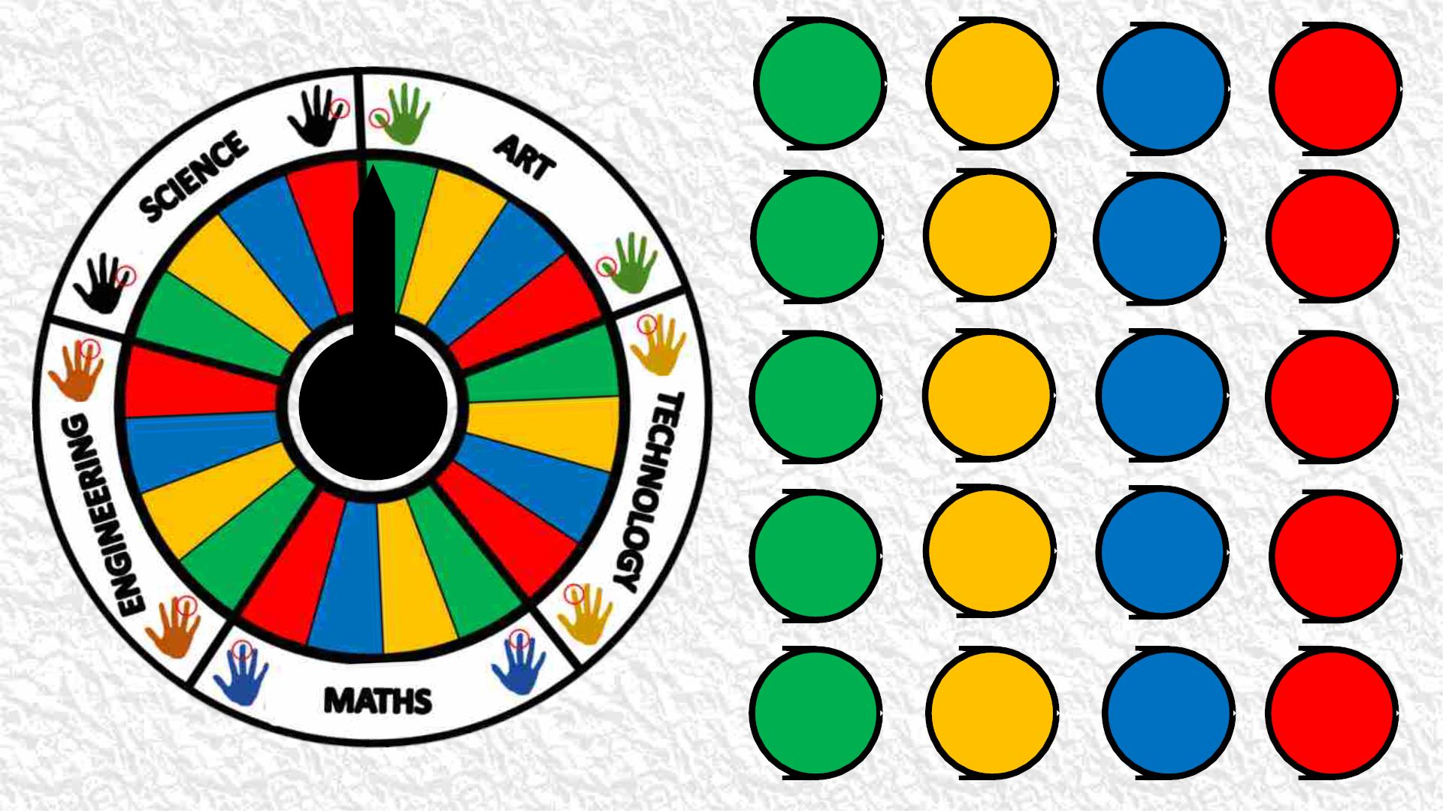
1
ENGIN
1
TECH
1
MATH
1
ART
2
MATH
2
SCIENCE
2
ENGIN
2
TECH
3
TECH
3
ART
3
SCIENCE
3
MATH
Spin!
4
ART
4
MATH
4
TECH
4
ENGIN
5
SCIENCE
5
ENGIN
5
ART
5
SCIENCE

Slide 7

Spin!
CONGRATULATIONS!
Aneliya Nankova
EEB4 - Belgium

