Slide 1
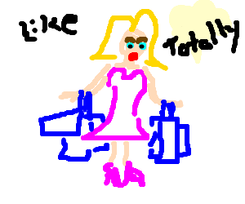
Prejudice and discrimination
Draw a stereotypical girl:
A stereotype is a general belief about a person or thing
What’s the difference?
Pre-judge or thoughts about a person or group
The act of treating someone differently
Prejudice
Discrimination

Slide 2
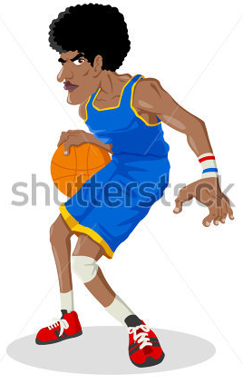
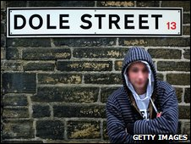
Prejudice
Pre-judge or thoughts about a person or group
Write down three examples of prejudice – you can use the images if you want

Slide 3
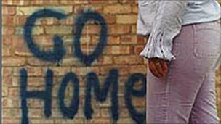
Discrimination
The act of treating someone differently
Write down three examples of discrimination – you can use the images if you want
Categories:
Racism
How many categories of discrimination can you list?

Slide 4
Why?
Fear
Media
Why do you think people have prejudices and discriminate others?
Religion
Experience
Local area
Parents
Time period

Slide 5
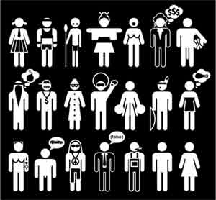
Plenary
“Prejudice is a natural part of being a human being”
To what extent do you agree with this statement? Explain your answer
1/5 Totally disagree
5/5 Totally agree

