Slide 1
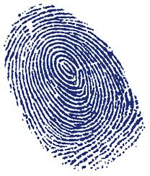
Identità

Slide 2
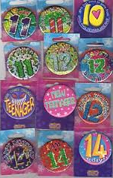
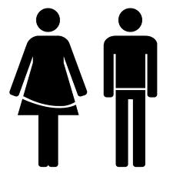
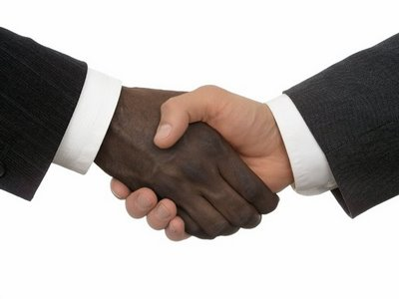
What is your identity?
Gender?
Race?
Age?
Miss Goddard: I am 25, white and female

Slide 3
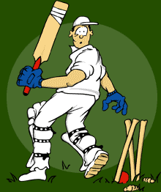
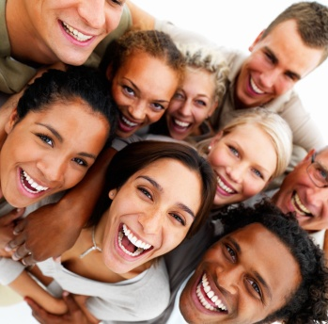
Discuss
Ask two people to define their identity using three words.
Eg – Joe
Plays Cricket
Likes going to parties
He’s very sociable

Slide 4
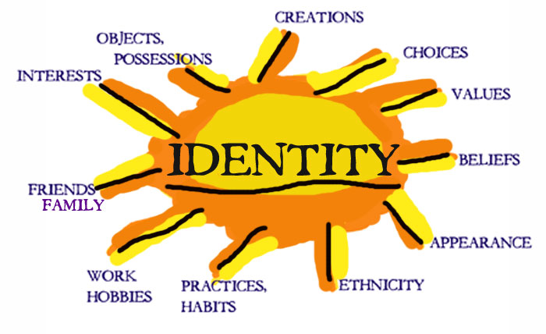
Is our identity as simple as this?
Gender?
Age?
Race?
What else is missing? Create an identity passport

Slide 5
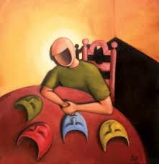
Definition
What is identity?
Identity is…
the condition of being oneself or itself, and not another.
Self, interests, name, location, music, food

Slide 6
How is identity formed?
Create a washing line and peg who and what creates a person’s identity
Parents
Country
Friends
Education

Slide 7
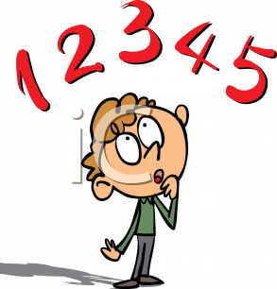
How important is identity?
1. Identity is an important part of being human.
2. No one has an ‘identity’, we are all the same.
3. Identity constantly changes depending on who you are, where you live.
Which quote do you agree with? Why?
How important is identity?
No importance
Very important

