Slide 1
EMPOWER STEaM EDUCATION WITH ai
AI can provide customized learning for students and give teachers more time to focus on the most important aspects of education
Artificial intelligence (AI) holds tremendous promise to improve our educational systems.
2021-1-ES01-KA220-SCH-000032742
Prepared by: Angela Cotoara
APRIL 2023

Slide 2
Table of Contents
Page 3
Page 7
Page 10
Page 15
01
02
03
04
Introduction
Why choose Education AI?
Is your school making the most of digital technologies for learning?
Conclusion

Slide 3
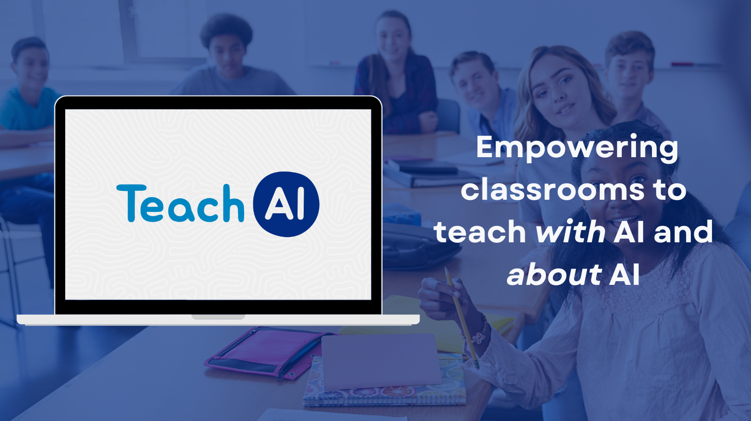
01 Introduction
Background: the E-SOC project
How to introduce AI in a STEAM class
Guidelines purpose

Slide 4
Introduction Overview
E-SOC Project
is a European project founded under the Erasmus + KA2 programme. It aims at tackling the low representation of girls in STEAM education (Science, Technology, Engineering and Mathematics) and subsequently women in STEAM careers, considering that one of the reasons why STEAM disciplines are unappealing to girls is the persistent stereotypes. In addition, teachers are not always equipped to manage gender diversity in their classrooms. Educational materials also lack female characters, role models likely to stir young girls' interest in these subjects from a young age,
interest in STEAM disciplines among girls. The E-SOC project focuses on the creation of an e-learning platform where educational and awareness-raising materials can be uploaded for use by secondary-level teachers (of pupils aged 12 to 18), which will enhance the girls’ number who choose STEAM education and plan STEAM careers.

Slide 5
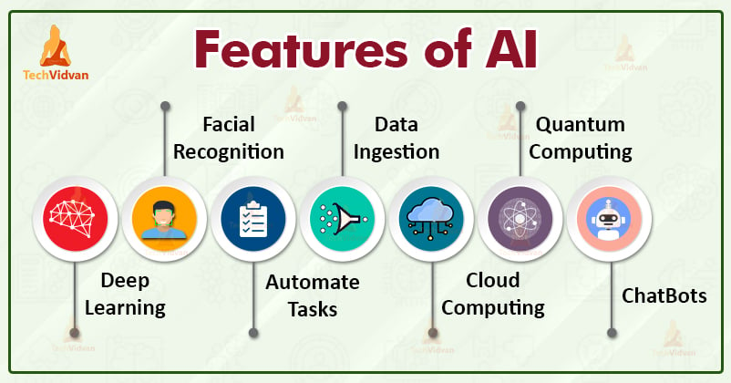
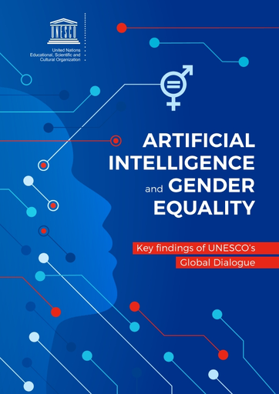
Introduction How to introduce AI in our class?
Artificial intelligence, or “AI,” is the ability for a computer to think and learn. With AI, computers can perform tasks that are typically done by people, including processing language, problem-solving, and learning. Artificial intelligence is a tool, much like other types of new technologies.
Following the publication of a White Paper on AI, in April 2021 the European Commission proposed a regulation (the Artificial Intelligence Act) laying down harmonised rules on AI and intending to safeguard European Union (EU) values and fundamental rights (including gender equality) and user safety.

Slide 6
Introduction If AI is the future, gender equity is essential
As the world faces many serious challenges — from climate change and poverty to displacement and social injustice – women and girls are key to tackling those issues and shaping future prosperity for all. Artificial Intelligence (AI), along with other digital tools, has the potential to help us address those challenges and open new opportunities. Seizing that potential requires us to take meaningful action to mitigate the risks AI poses to women and girls, and to use AI to advance gender equity.
What is artificial intelligence (AI)? This animated video describes how artificial intelligence works, where it can be found, and how it influences our lives.
https://www.youtube.com/watch?v=NbEbs6I3eLw
N.B. Teachers can be assisted for the following tasks:
Marking assignments
Using Virtual teaching assistants to answer students’ questions
Apply adaptive learning
Analise students’ abilities, interests, and potential through classroom interaction, even recommend their career path.

Slide 7
02 Why Choose Education AI?
Our approach to computer science learning:
Granular approach built from individual learning objectives
Student journey seamlessly mapped from fundamentals to advanced
Arrange topics to best suit your students
Adapting lesson plans to your student's learning progression
Save time with automatic marking of questions and code.

Slide 8
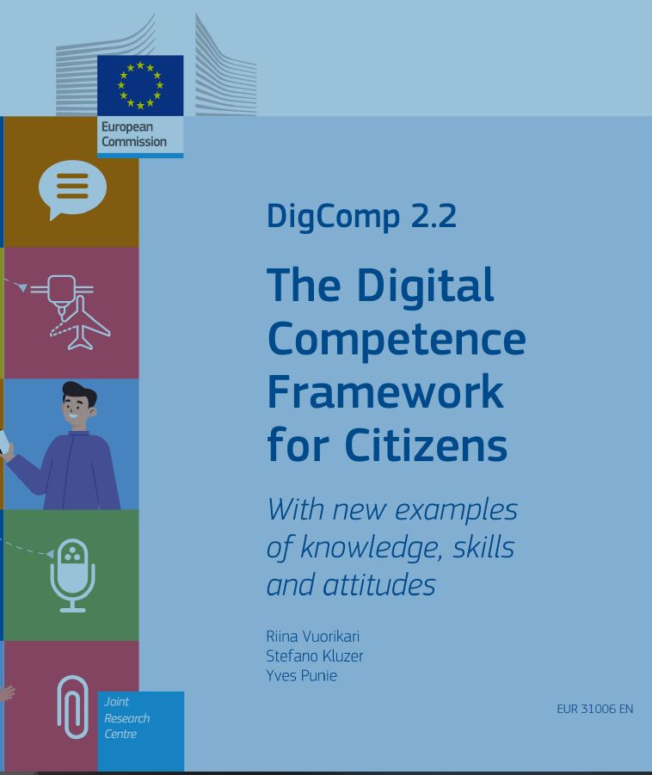
A new curriculum for a digital and AI-powered Education
The framework emphasises the role that digital technologies have in supporting six key areas of knowledge: 1-Understanding ICT in education; 2-Curriculum & Assessment; 3-Pedagogy; 4-ICT; 5-Organisation & Administration; 6-Teacher Professional Learning. The framework sets three phases of knowledge acquisition: 1-technology literacy; 2-knowledge deepening; 3-knowledge creation
Another framework along this same line of support to teachers in the integration of digital technologies to their practices is “ICT Competencies and Standards from the Pedagogical Dimension”, developed by UNESCO Santiago and the Universidad Javeriana (2016).This framework was created to contribute in the vision of teacher training to face the challenge of teaching in Section II Preparing learners to thrive in the future with AI
DigCompEdu is structured in five competency areas that describe the key components of digital competencies, namely Information and data literacy; Communication and collaboration; Digital content creation; Safety; and Problem solving. The framework takes these dimensions and maps them through four proficiency levels: foundation, intermediate, advanced, highly specialized.

Slide 9
Digital competencies frameworks
On 25 October 2022, the EC published the final report of an expert group as well as ‘Ethical guidelines on the use of AI and data in teaching and learning for educators’.
Based on the increasing use of AI in education, the final report makes policy recommendations; the guidelines give tips and advice for teachers, all with the goal of improving the understanding of AI for teaching and learning and engaging with these new technologies in a positive, critical and ethical way.
AI can be used for the following purposes in education: i. Analyse learners’ mindsets for evidence-based education, ii. Predict students’ achievements, iii. Make decisions on student enrolment, iv. Automate the scoring of assignments, v. Predict students’ progress and dropout, vi. Personalise learning technologies, vii. Allow students to self-regulate their own learning, viii. Automate learning via chatbots, and ix. Detect support demands and provide individualised support for students with special needs.
NB There are four ethical considerations when using AI in education: i. agency, ii. social fairness, iii. humanity, and iv. justified choice. Based on all these considerations, the guidelines for educators to integrate ethics in the use of AI in education were edited to manage the risks that are associated with it.

Slide 10
03 Is your school making the most of digital technologies for learning?
SELFIE
is a free, customisable tool to help schools reflect on how they use digital technologies to support learning.

Slide 11
Introducing Computational Thinking
Schooling’ must be distinguished from ‘learning’: While schooling happens within structured learning environments contained within a fixed time and place, learning occurs in a continual fashion, regardless of time and place. With the existence of mobile technologies, for instance, it has even become more apparent that learning can occur well outside the bounds of traditional, brick-and-mortar educational institutions (Woolf et al., 2013). Massively open online courses (MOOCs) and online learning platforms such as Khan Academy are alternative channels by which individuals can access training on AI-related skills, with various universities offering online courses on programming, data science and machine learning, for instance.
Coursera, edX, iversity, Future Learn, Udacity, CognitiveClass.ai, etc. are examples of such platforms which, in some cases, say that they are applying NLP (Natural Language Processing) and Machine Learning in combination with Crowdsourcing, for example, to grade short answers, coding exercises, vocabulary and even automatically generate ‘wh’ (who/what/when/where/why) questions. MOOCs may be considered to fall within a wider category of “Large-scale Learning Environments”. Apart from the examples of formal MOOC platforms given above, other less formal systems, usually based on communities, have a relevant impact on how many people learn.
NB. AI-powered services have already become prevalent in human lives in many places, including the least developed countries.

Slide 12
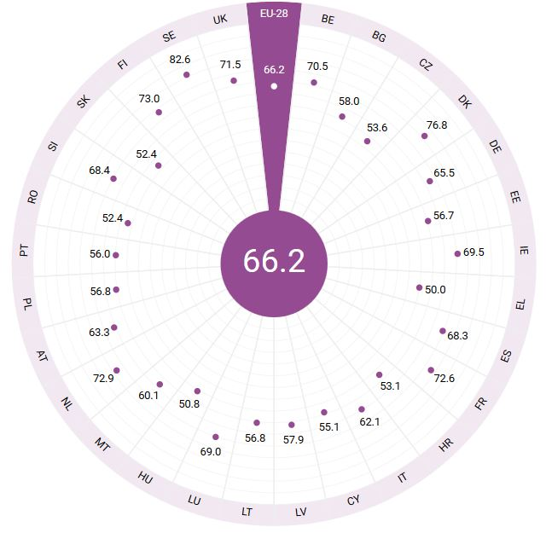
The Gender equality strategy 2020-2025
The EU undertook a number of policy initiatives for greater equality between women and men. The Gender Equality Strategy 2020-2025 and the Gender Equality Index 2022 are two measures that aim to close the gender gap in general. As far as the education sector is concerned, the European Commission works on making education and training more inclusive and gender sensitive within the EEA. Action 13 of the Digital Education Action Plan 2021-2027 for more gender-balanced participation in STEM represents just one example. In addition, practical examples from EU Member States, European stakeholders, EU co-funded projects and international organisations for a more gender equal education can be found in the appendices of the paper. One of the practical sources of inspirations is the EU funded project Gender Awareness, Tackling stereotypes in Education (GATE) aiming to raise awareness of gender stereotypes in primary education through tools and activities.

Slide 13
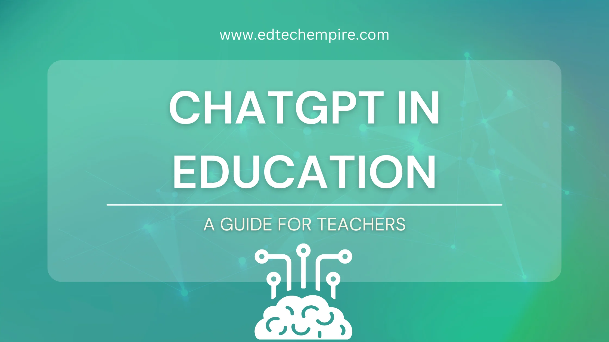
Artificial Intelligence in teaching and learning
The education sector is both customer and actor in the face of sweeping developments in AI-powered technology. In this regard, the education component becomes key when countries develop national AI strategies, as we’ve seen in the cases of Australia, China, Estonia, France, Singapore, South Korea and, albeit more recently, the United States.
The development of public policies regarding AI in education is still in its infancy, but it is a field that will most likely grow exponentially in the next ten years. It is difficult to find some common components at such an early stage, but some issues are starting to emerge as key factors shown by the study cases.
With this comprehensive view in mind, what are the possibilities for introducing AI in education in developing countries? Technology has open new opportunities for countries facing large social challenges. In Africa, access to mobile phones has grown exponentially in the last 15 years, driving economic growth (Aker & Mbiti, 2010). New discussions are emerging in developing countries to use the power of AI to promote social equality.
While the EU regulation on AI is still being negotiated, the new ethical guidelines give support and advice to teachers using AI in schools.

Slide 14
Preparing teachers for AI-powered education
Learning analytics platforms can use predictive algorithms to help teachers diagnose and anticipate learning difficulties faced by learners and thus implement personalised interventions to respond to those difficulties. However, while predictive algorithms certainly facilitate data analysis and interpretation, these algorithms are not what make learning analytics systems powerful. The effectiveness of learning analytics systems lies in their usefulness and relevance to learners and educators.
Real-time data processing should translate into real-time feedback, quicker intervention and individualised instruction. As such, educators continue to play the primary role. Teachers and head teachers should be given sufficient autonomy to manage their respective classrooms and schools, founded on the notion that they are most familiar with the needs of their learners.
Teachers will therefore remain at the frontline of education; it is misinformed to say that AI can replace teachers.
While AI has many positive applications, there are also societal and ethical concerns that should be addressed. Most people have at least read something about AI systems discriminating unfairly,taking life-impacting decisions in a non-transparent way, ready to take all our jobs and set to wrest control from humans.There is much work going on today that tries to come up with answers to such concerns (The European Commission, 2018).

Slide 15
04 Conclusion

Slide 16
Conclusion
Yet, at least when it comes to education, there is also room for cooperation, whose basis is knowledge sharing. To promote the discussion and the relevance of adopting comprehensive perspectives of AI in education there is a need of more information about how countries are moving forward in this uncertain and constantly changing territory.
The creation of an Observatory of AI in education to look at relevant initiatives of AI in education and to inform on national and international AI strategy plans may be seen as a platform for knowledge sharing and peer learning.
However, these responses remain independent of a holistic and concerted policy framework for AI in education. Nonetheless, it is important to note that the initiatives presented are worthwhile starting measures that can guide the creation of a coherent policy framework.
Inevitably, AI is a field that spurs innovation and, by doing so, increases countries’ competitiveness. Countries will continue competing in such a rich and rapidly evolving arena.

Slide 17
Disclaimer on publications
This project has been funded with support from the European Commission. This publication reflects the views only of the author, and the Commission cannot be held responsible for any use which may be made of the information contained therein.

