Slide 1
The world of STEAM: the famous faces
Busting the myths
Gender bias in STEAM world

Slide 2
Brainstorm
In your group:
1. Write a list of famous scientists, engineers, designers, technology leaders that you know.
2. Now we will share with the class.

Slide 3
Get ready…
Look at the slides.
Can you name these famous people?
How many of them did you already have on your lists?

Slide 4
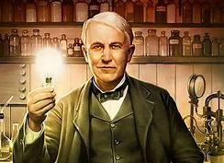
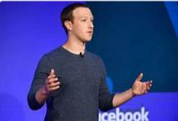
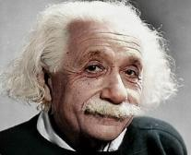
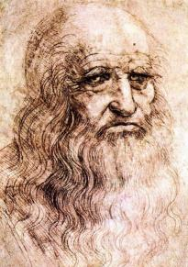
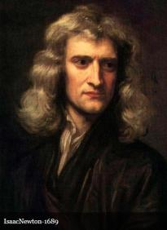
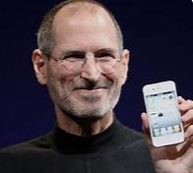

Slide 5
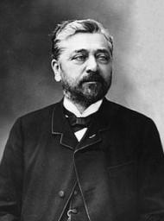
Who designed this?
Gustave Eiffel

Slide 6
Who invented this?
Henry Ford

Slide 7
What did you notice about all these famous faces and names?
They are all men!
Does this mean that women haven’t made any scientific discoveries or inventions?

Slide 8
Who are these people?
Can you name them?
What did they do?

Slide 9
Marie Curie
Famous for her research on Radioactivity, which led to the invention of the x-ray.
Awarded a nobel prize, jointly with her husband.

Slide 10
Jane Goodall
A primate scientist and animal rights activist, famous for her work with chimpanzees, despite having no formal Scientific training when she started out!

Slide 11
Katherine Johnson
Nasa Research Mathematician whose calculations were crucial to NASA’s space programme and attempts to orbit and land on the moon.

Slide 12
Caroline Herschel
An Astronomer who made significant discoveries, including identifying several comets. She was the first woman in England to be paid as a scientist.

Slide 13
Sau Lan Wu
A Chinese scientist and particle physicist, who made several discoveries. She works with the team at the European Organization for Nuclear Research (CERN), the location of the Large Hadron Collider.

Slide 14
Barbara McClintock
A geneticist who made discoveries in her studies of corn, which led to the understanding of hereditary traits. Awarded a nobel prize (not jointly – the first woman to receive this honour!)

Slide 15
Ada Lovelace
A mathematician who worked with Charles Babbage on the first ‘analytical engine’ idea, which led to the creation of the computer. Often referred to as the world’s first ‘computer programmer’.

Slide 16
Grace Hopper
A computer scientist whose work led to the development of COBOL, an early programming language we is still used to this day. In 1947, she recorded the worlds first ever real computer bug.

Slide 17
Susan Wojcicki
Google’s sixteenth employee and initial marketing manager, she is now CEO of You Tube.

Slide 18
Reshma Saujani
A New York Times bestselling author and the brains behind the famous TED Talk, “Teach girls bravery, not perfection. She is the founders and CEO of Girls Who Code.

Slide 19
Zaha Hadid
An architect who designed the London Aquatics Center and the Guangzhou Opera House. Zaha Hadid was nicknamed the “Queen of the curve” and as a result, received awards like the Pritzker Architecture Price, which she won in 2004. She was the first female architect to have won this.

Slide 20
Sheryl Sandberg
She graduated from Harvard College in 1991 with a B.A in economics, where she also co-founded Women in Economics and Government. She then enrolled at Harvard Business School in 1993 to earn her M.B.A. She met Mark Zuckerberg who offered her the role of Facebook COO.

Slide 21
What have you learned?
How many of those influential women had you heard of?
What does this tell us?
What conclusions can we draw from this about gender bias in the world of science and technology?

Slide 22
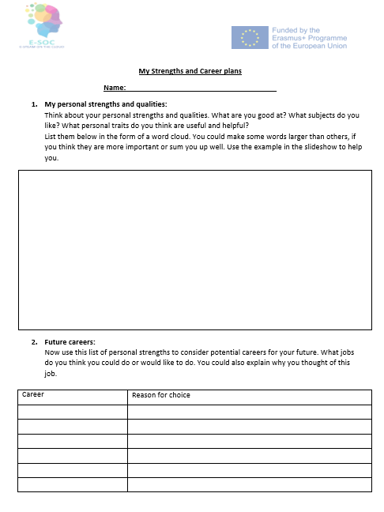
Reflection:
My personal Strengths and Career Plans

Slide 23
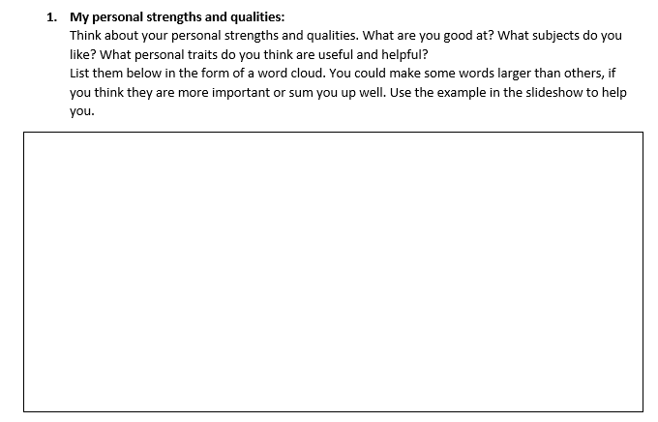
See next slide for an example of a word cloud.
Some of the words may be useful to you.

Slide 24
Example of a strengths word cloud

Slide 25
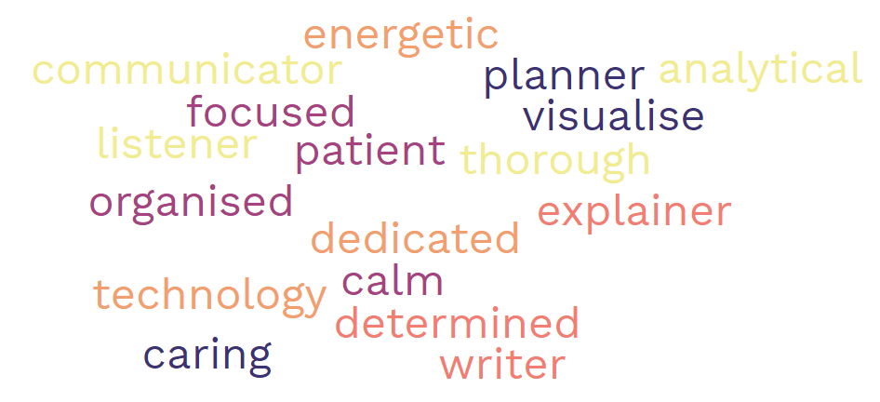
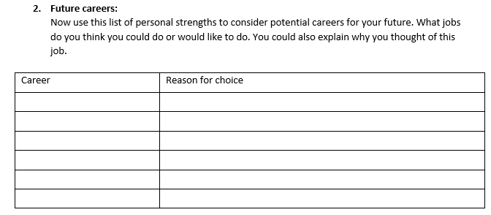

Slide 26
Sharing our ideas
Would you like to share some of your personal strengths?
What potential careers are you interested in?
How many of them are linked to the world of STEAM?
Can you see any gender bias in the career choices of the boys and girls in the class?
What have we learned about gender bias in the world of STEAM from this lesson?

Slide 27
Further discussion:
Watch the movie hidden figures.
Explore the effects of gender bias and racism on these women.

